Slide 1
Deep learning
簡廷因 Ting-Ying Chien
2022.05.26

Slide 2
Outline
Artificial Neural Network (ANN)
Convolutional Neural Networks (CNN)
Recurrent Neural Networks (RNN)
Long Short-Term Memory (LSTM)

Slide 3
Artificial Neural Network (ANN)

Slide 4
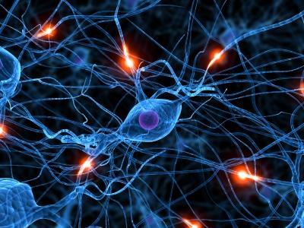
Artificial Neural Network
An ANN is based on a collection of connected units or nodes called artificial neurons which loosely model the neurons in a biological brain.
A neural network is a model characterized by an activation function, which is used by interconnected information processing units to transform input into output

Slide 5
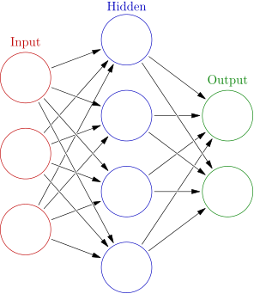
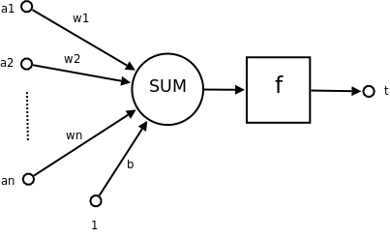
Artificial Neural Network
artificial neurons

Slide 6
Artificial Neural Network
> install.packages("neuralnet")
> library(neuralnet)
# Read the Data
> data = read.csv("cereals.csv", header=T)
> data = data[,c(4:8,16)]
# Random sampling
> samplesize = 0.60 * nrow(data)
> set.seed(80)
> index = sample( seq_len ( nrow ( data ) ), size = samplesize )
## Scale data for neural network
> max = apply(data , 2 , max)
> min = apply(data, 2 , min)
> scaled = as.data.frame(scale(data, center = min, scale = max - min))

Slide 7
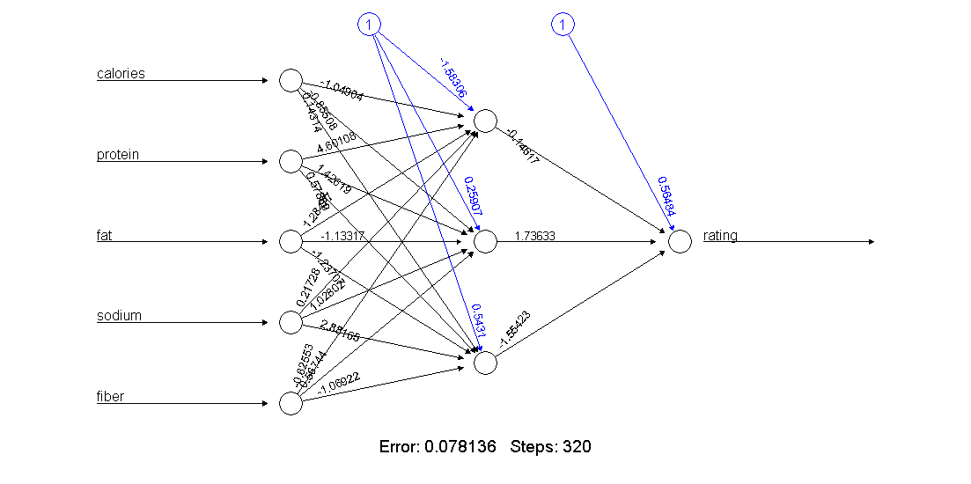
Artificial Neural Network
# creating training and test set
> datatrain = data[index,]
> datatest = data[-index,]
> trainNN = scaled[index , ]
> testNN = scaled[-index , ]
# fit neural network
> set.seed(2)
> NN = neuralnet(rating ~ calories + protein + fat + sodium + fiber, + trainNN, hidden = 3 , linear.output = T )
# plot neural network
> plot(NN)

Slide 8
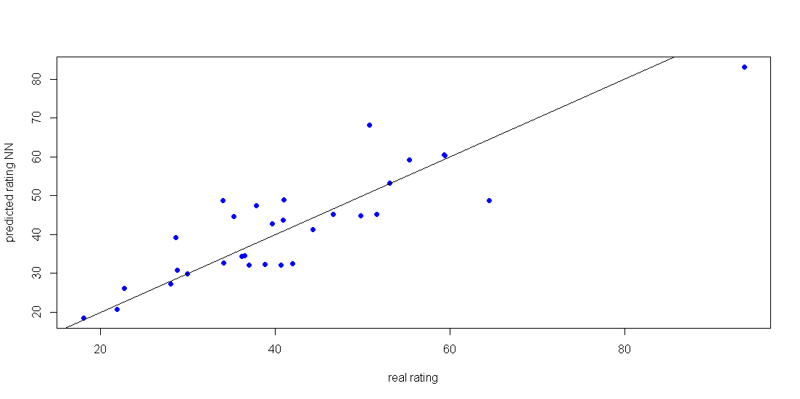
Artificial Neural Network
# Prediction using neural network
> predict_testNN = compute(NN, testNN[,c(1:5)])
> predict_testNN = (predict_testNN$net.result * (max(data$rating) - min(data$rating))) + min(data$rating)
> plot(datatest$rating, predict_testNN, col='blue', pch=16, ylab = "predicted rating NN", xlab = "real rating")
> abline(0,1)
# Calculate Root Mean Square Error (RMSE)
> RMSE.NN = (sum((testNN$rating - predict_testNN)^2) / nrow(testNN)) ^ 0.5

Slide 9
Exercise
Dataset
train=read.table("train_data.csv", header=T, sep=",")
test=read.table("test_data.csv", header=T, sep=",")
ctrain=scan("ctrain.txt",what=character())
ctest=scan("ctest.txt",what=character())
ctrain = as.vector(ifelse(ctrain=="L",1,0))
ctest = as.vector(ifelse(ctest=="L",1,0))
Develop a Artificial Neural Network to predict whether the patient is sick or not.
Result >= 0.5 as “L”
Calculate the TP, FP, TN and FN
Calculate the accuracy, sensitivity, specificity and precision

Slide 10
Convolutional Neural Networks (CNN)

Slide 11
Convolutional Neural Networks (CNN)
CNNs use a variation of multilayer perceptions designed to require minimal preprocessing
Applications in image and video recognition, recommender systems and natural language processing.
The CNN is based on the spatiality features.

Slide 12
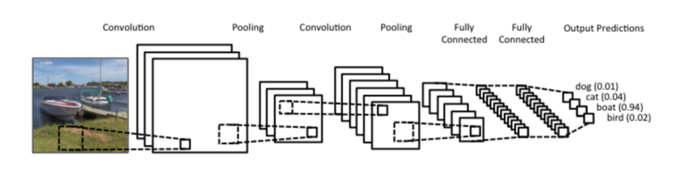
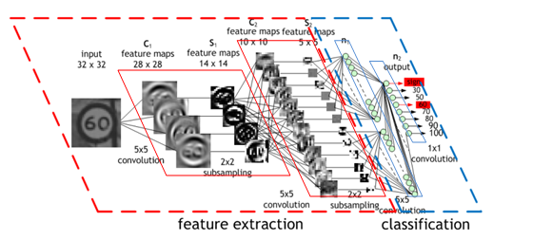
Convolutional Neural Networks (CNN)
Architecture

Slide 13
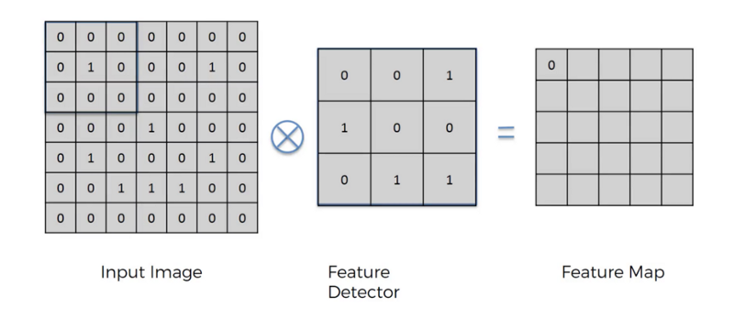
Convolutional Neural Networks (CNN)
Convolution Layer
Convolutional layers apply a convolution operation to the input, passing the result to the next layer.

Slide 14
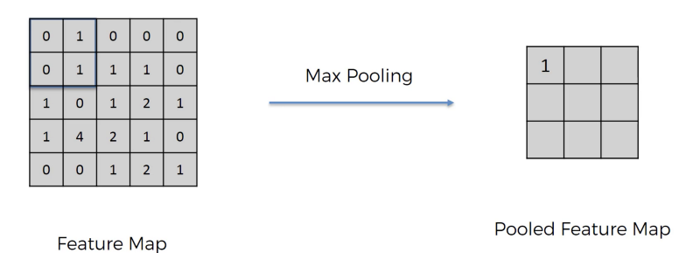
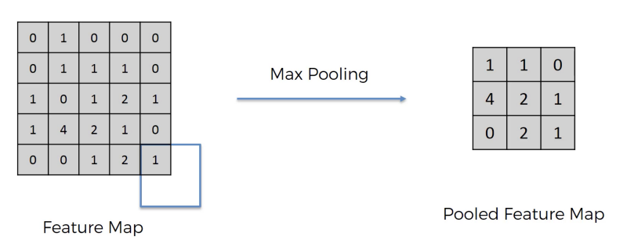
Convolutional Neural Networks (CNN)
Pooling Layer
Convolutional networks may include local or global pooling layers, which combine the outputs of neuron clusters at one layer into a single neuron in the next layer
Max pooling
Mean pooling

Slide 15
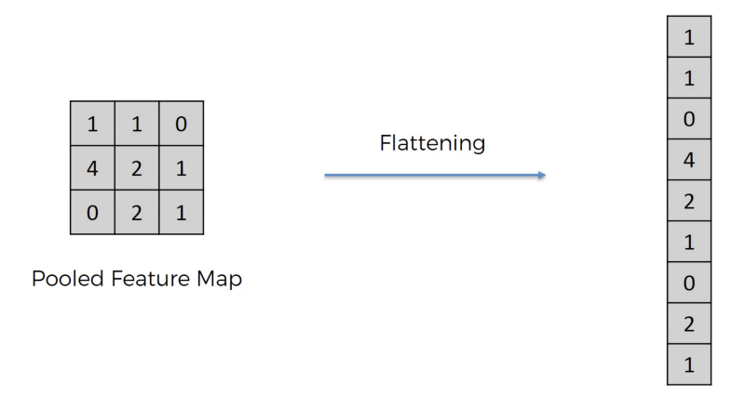
Convolutional Neural Networks (CNN)
Fully Connected Layer
Fully connected layers connect every neuron in one layer to every neuron in another layer.

Slide 16
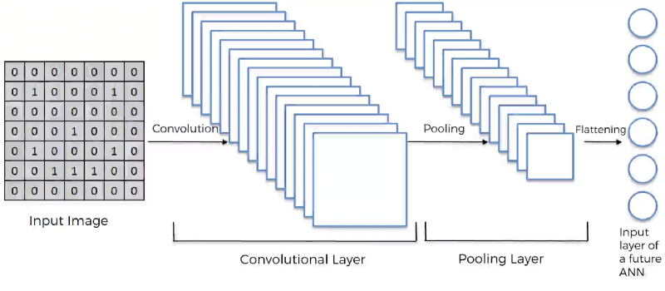
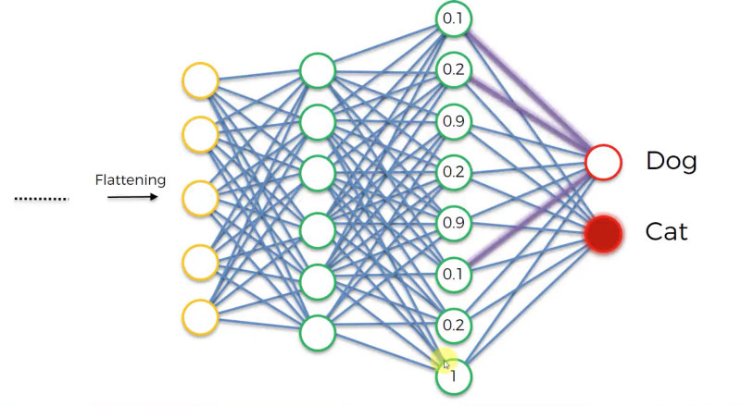
Convolutional Neural Networks (CNN)

Slide 17
Install package
> install.packages("tensorflow")
> install.packages("keras")
> library(tensorflow)
> library(keras)

Slide 18

MNIST dataset
handwritten digits
http://yann.lecun.com/exdb/mnist/

Slide 19
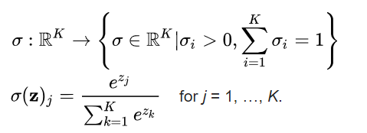
Activation function
Softmax
normalized exponential function
Example:
[1, 2, 3, 4, 1, 2, 3] => [0.024, 0.064, 0.175, 0.475, 0.024, 0.064, 0.175]

Slide 20
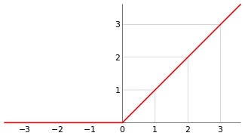

Activation function
Relu
rectified linear unit

Slide 21
Environment setting (windows GPU)
Download & install cuda
https://www.tensorflow.org/install/gpu#hardware_requirements
https://www.nvidia.com/drivers
Download & unzip cudnn
https://developer.nvidia.com/cudnn
Setting %PATH
https://www.tensorflow.org/install/gpu
Rename file
cusolver64_11.dll To cusolver64_10.dll
https://stackoverflow.com/questions/65608713/tensorflow-gpu-could-not-load-dynamic-library-cusolver64-10-dll-dlerror-cuso

Slide 22
Convolutional Neural Networks (CNN)
> library(tensorflow)
> library(keras)
> install_tensorflow()
#> install_tensorflow(version = "gpu")
# install miniconda automatic
#> reticulate::install_miniconda()
#> install_tensorflow(method = 'conda', envname = 'r-reticulate')
> batch_size = 128
> num_classes = 10
> epochs = 12
# Input image dimensions
> img_rows = 28
> img_cols = 28
# The data, shuffled and split between train and test sets
> mnist = dataset_mnist()
> x_train = mnist$train$x
> y_train = mnist$train$y
> x_test = mnist$test$x
> y_test = mnist$test$y
# Redefine dimension of train/test inputs
> x_train = array_reshape(x_train, c(nrow(x_train), img_rows, img_cols, 1))
> x_test = array_reshape(x_test, c(nrow(x_test), img_rows, img_cols, 1))
> input_shape = c(img_rows, img_cols, 1)

Slide 23
Convolutional Neural Networks (CNN)
# Transform RGB values into [0,1] range
> x_train = x_train / 255
> x_test = x_test / 255
> cat('x_train_shape:', dim(x_train), '\n')
> cat(nrow(x_train), 'train samples\n')
> cat(nrow(x_test), 'test samples\n')
# Convert class vectors to binary class matrices
> y_train = to_categorical(y_train, num_classes)
> y_test = to_categorical(y_test, num_classes)

Slide 24
Convolutional Neural Networks (CNN)
# Define Model -----------------------------------------------------------
> model = keras_model_sequential()
> model %>%
+ layer_conv_2d(filters = 32, kernel_size = c(3,3), activation = 'relu',
+ input_shape = input_shape) %>%
+ layer_conv_2d(filters = 64, kernel_size = c(3,3), activation = 'relu') %>%
+ layer_max_pooling_2d(pool_size = c(2, 2)) %>%
+ layer_dropout(rate = 0.25) %>% # dropout some data to avoid overfitting
+ layer_flatten() %>% #
+ layer_dense(units = 128, activation = 'relu') %>% # Fully Connected Layer
+ layer_dropout(rate = 0.5) %>% # dropout some neurons to avoid overfitting
+ layer_dense(units = num_classes, activation = 'softmax')
# Compile model
> model %>% compile(
+ loss = loss_categorical_crossentropy,
+ optimizer = optimizer_adadelta(),
+ metrics = c('accuracy')
+ )

Slide 25
Convolutional Neural Networks (CNN)
# Train & Evaluate -------------------------------------------------------
> model %>% fit(
+ x_train, y_train,
+ batch_size = batch_size,
+ epochs = epochs,
+ verbose = 1, # log type
+ validation_data = list(x_test, y_test)
+ )
> scores = model %>% evaluate(
+ x_test, y_test, verbose = 0
+ )
# Output metrics
> cat('Test loss:', scores[[1]], '\n')
> cat('Test accuracy:', scores[[2]], '\n')

Slide 26
CNN reference
https://tensorflow.rstudio.com/keras/articles/examples/mnist_cnn.html
https://ithelp.ithome.com.tw/articles/10187282
Deep Learning for Natural Language Processing in R
https://channel9.msdn.com/Events/useR-international-R-User-conferences/useR-International-R-User-2017-Conference/Deep-Learning-for-Natural-Language-Processing-in-R

Slide 27

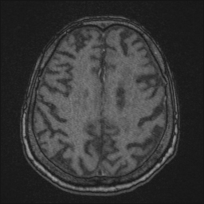
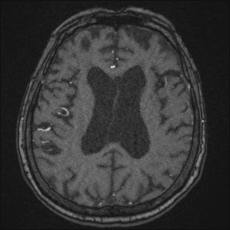
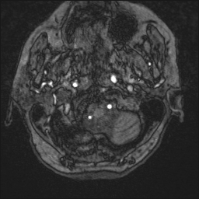
Example
A Convolutional Neural Network Model to Ascertain Whether a Patient Has Had a Stroke

Slide 28
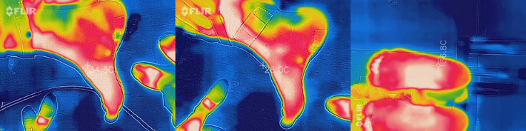
Example
Plantar Fasciitis Detection Based on Deep Learning Architecture

Slide 29
Recurrent Neural Networks (RNN) Long Short-Term Memory (LSTM)

Slide 30
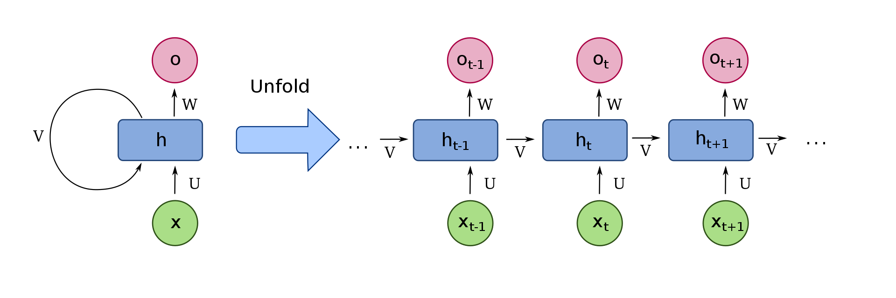
Recurrent Neural Networks (RNN)
Exhibit dynamic temporal behavior for a time sequence
Have been applied to natural language processing

Slide 31
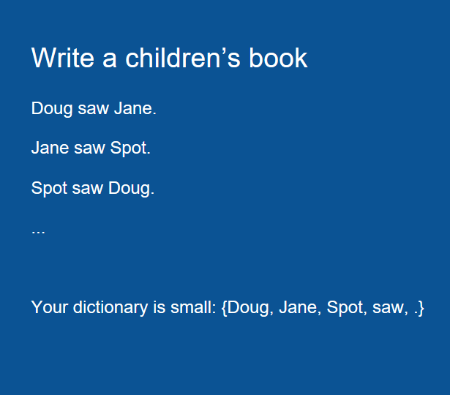
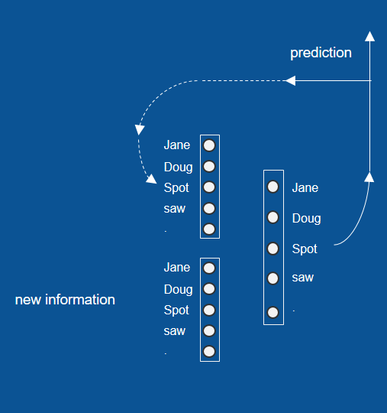
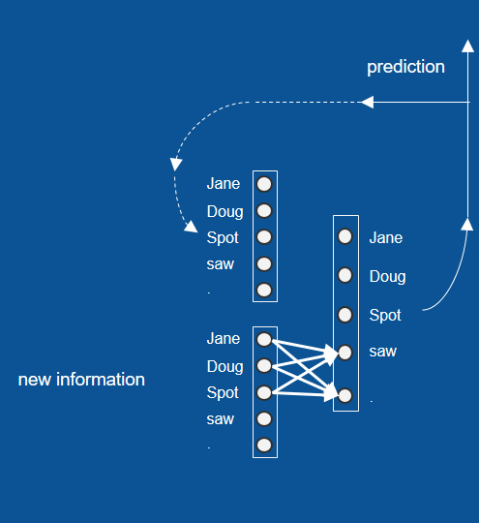
Recurrent Neural Networks (RNN)
NLP in RNN

Slide 32
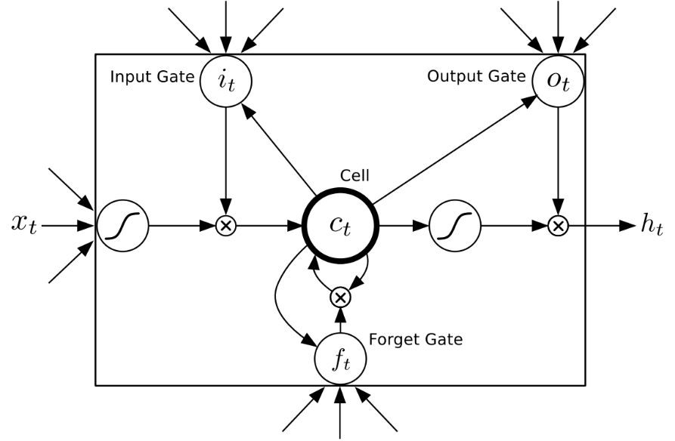
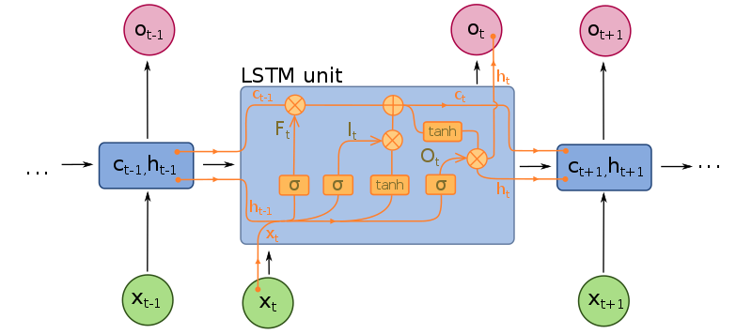
Long Short-Term Memory (LSTM)
A common LSTM unit is composed of a cell, an input gate, an output gate and a forget gate.

Slide 33
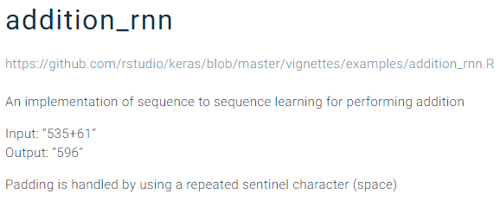
Recurrent Neural Networks (RNN)
https://tensorflow.rstudio.com/keras/articles/examples/addition_rnn.html

Slide 34
Recurrent Neural Networks (RNN)
> library(keras)
> library(stringi)
# Function Definitions ----------------------------------------------------
# Creates the char table and sorts them.
> learn_encoding = function(chars){
+ sort(chars)
+ }
# Encode from a character sequence to a one hot integer representation.
> encode = function(char, char_table){
+ strsplit(char, "") %>%
+ unlist() %>%
+ sapply(function(x){
+ as.numeric(x == char_table)
+ }) %>%
+ t()
+ }
# Decode the one hot representation/probabilities representation to their character output.
> decode = function(x, char_table){
+ apply(x,1, function(y){
+ char_table[which.max(y)]
+ }) %>% paste0(collapse = "")
+ }

Slide 35
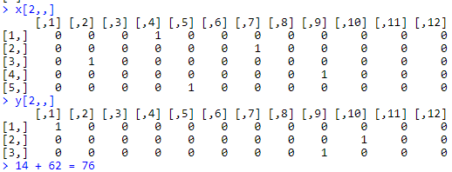
Recurrent Neural Networks (RNN)
# Parameters --------------------------------------------------------------
# Parameters for the model and dataset
> TRAINING_SIZE = 50000
> DIGITS = 2
> HIDDEN_SIZE = 128
> BATCH_SIZE = 128
> LAYERS = 1
# Maximum length of input is 'int + int' (e.g., '345+678').
# Maximum length of int is DIGITS
> MAXLEN = DIGITS + 1 + DIGITS
# All the numbers, plus sign and space for padding
> charset = c(0:9, "+", " ")
> char_table = learn_encoding(charset)
# Data Preparation --------------------------------------------------------
> load("rnn.rdata")
1
4
+
6
2
7
6

Slide 36
Recurrent Neural Networks (RNN)
# Initialize sequential model
> model = keras_model_sequential()
> model %>%
+ layer_lstm(HIDDEN_SIZE, input_shape=c(MAXLEN, length(char_table))) %>%
+ layer_repeat_vector(DIGITS + 1)
> for(i in 1:LAYERS)
+ model %>% layer_lstm(HIDDEN_SIZE, return_sequences = TRUE)
> model %>%
+ time_distributed(layer_dense(units = length(char_table))) %>%
+ layer_activation("softmax")
# Compiling the model
> model %>% compile(
+ loss = "categorical_crossentropy",
+ optimizer = "adam",
+ metrics = "accuracy"
)
Ref:https://www.twblogs.net/a/5c947540bd9eee35fc15e27e

Slide 37
Recurrent Neural Networks (RNN)
# Fitting loop
> model %>% fit(
+ x = x_train,
+ y = y_train,
+ batch_size = BATCH_SIZE,
+ epochs = 5,
+ validation_data = list(x_val, y_val)
+ )
# Predict for a new observation
> new_obs = encode("55+22", char_table) %>%
+ array(dim = c(1,5,12))
> result = predict(model, new_obs)
> result = result[1,,]
> decode(result, char_table)

Slide 38
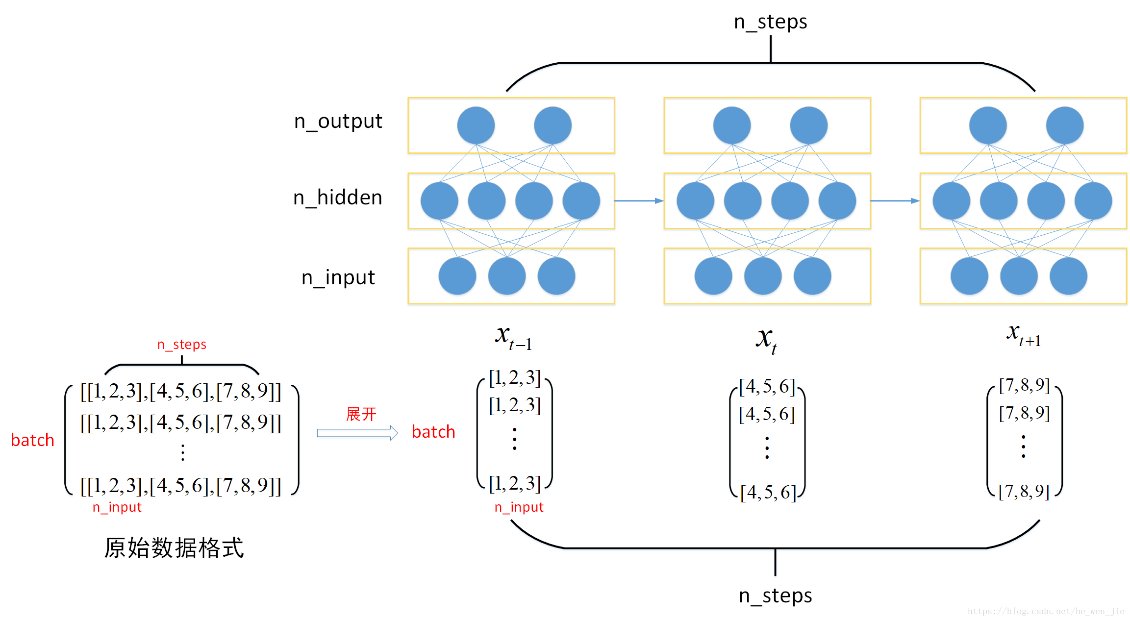
Recurrent Neural Networks (RNN)
128 units
3 steps
Ref:https://www.twblogs.net/a/5c947540bd9eee35fc15e27e

Slide 39
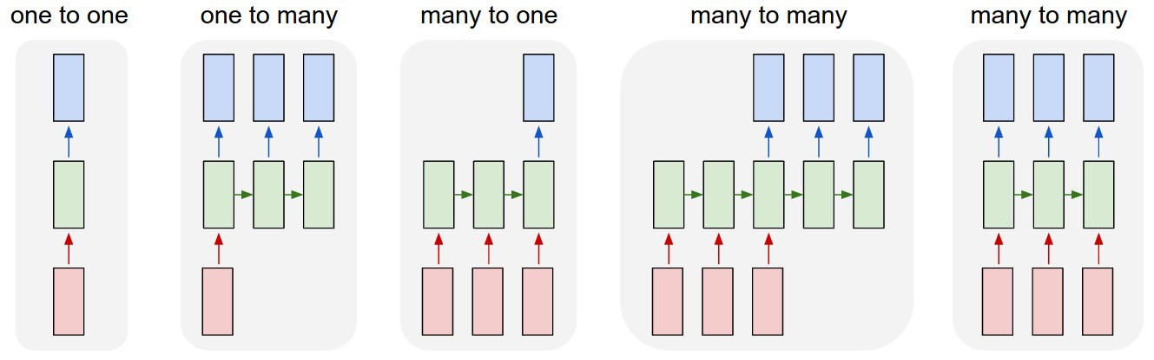
Recurrent Neural Networks (RNN)
Ref: https://blog.csdn.net/u012193416/article/details/79477220

Slide 40
Long Short-Term Memory (LSTM)
https://tensorflow.rstudio.com/keras/articles/examples/imdb_lstm.html
IMDB dataset
Movie reviews sentiment classification
50000 movies reviews from IMDB
labeled by sentiment (positive/negative)
each review is encoded as a sequence of word indexes (integers)
words are indexed by overall frequency in the dataset

Slide 41
Long Short-Term Memory (LSTM)
> library(keras)
> max_features = 20000
> batch_size = 32
# Cut texts after this number of words (among top max_features most common words)
> maxlen = 80
> load("imdb.rdata")
> x_train = imdb$train$x
> y_train = imdb$train$y
> x_test = imdb$test$x
> y_test = imdb$test$y
> x_train = pad_sequences(x_train, maxlen = maxlen)
> x_test = pad_sequences(x_test, maxlen = maxlen)

Slide 42
Long Short-Term Memory (LSTM)
> model = keras_model_sequential()
> model %>%
+ layer_embedding(input_dim = max_features, output_dim = 128) %>%
+ layer_lstm(units = 64, dropout = 0.2, recurrent_dropout = 0.2) %>%
+ layer_dense(units = 1, activation = 'sigmoid')
# Try using different optimizers and different optimizer configs
> model %>% compile(
+ loss = 'binary_crossentropy',
+ optimizer = 'adam',
+ metrics = c('accuracy')
+ )
> model %>% fit(
+ x_train, y_train,
+ batch_size = batch_size,
+ epochs = 5,
+ validation_data = list(x_test, y_test)
+ )
> scores = model %>% evaluate(
+ x_test, y_test,
+ batch_size = batch_size
+ )
> cat('Test score:', scores[[1]])
> cat('Test accuracy', scores[[2]])

Slide 43
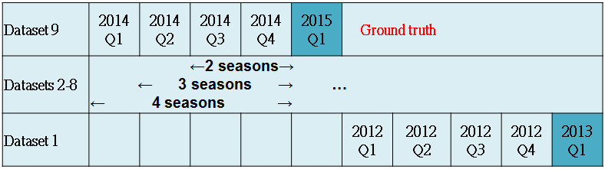
Example
A Clinical Decision Support System for Diabetes Patients with Deep Learning: Experience of a Taiwan Medical Center

Slide 44
Reference
https://www.slideshare.net/odsc/alec-radfordodsc-presentation
https://techblog.gumgum.com/articles/deep-learning-for-natural-language-processing-part-2-rnns
https://brohrer.mcknote.com/zh-Hant/how_machine_learning_works/how_rnns_lstm_work.html

Slide 45
Q&A

